Slide 1
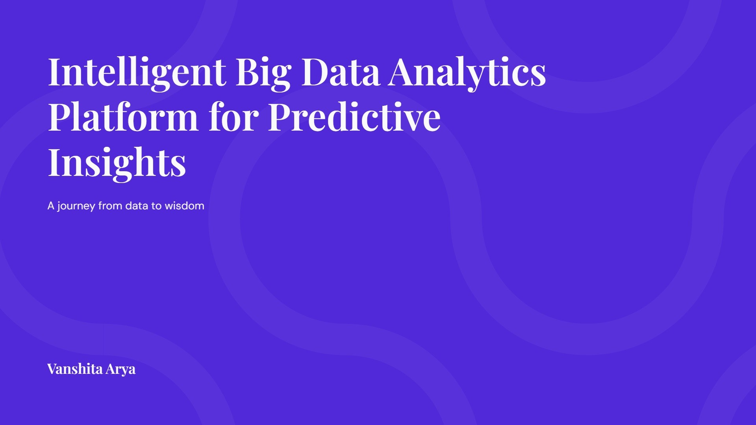

Slide 2
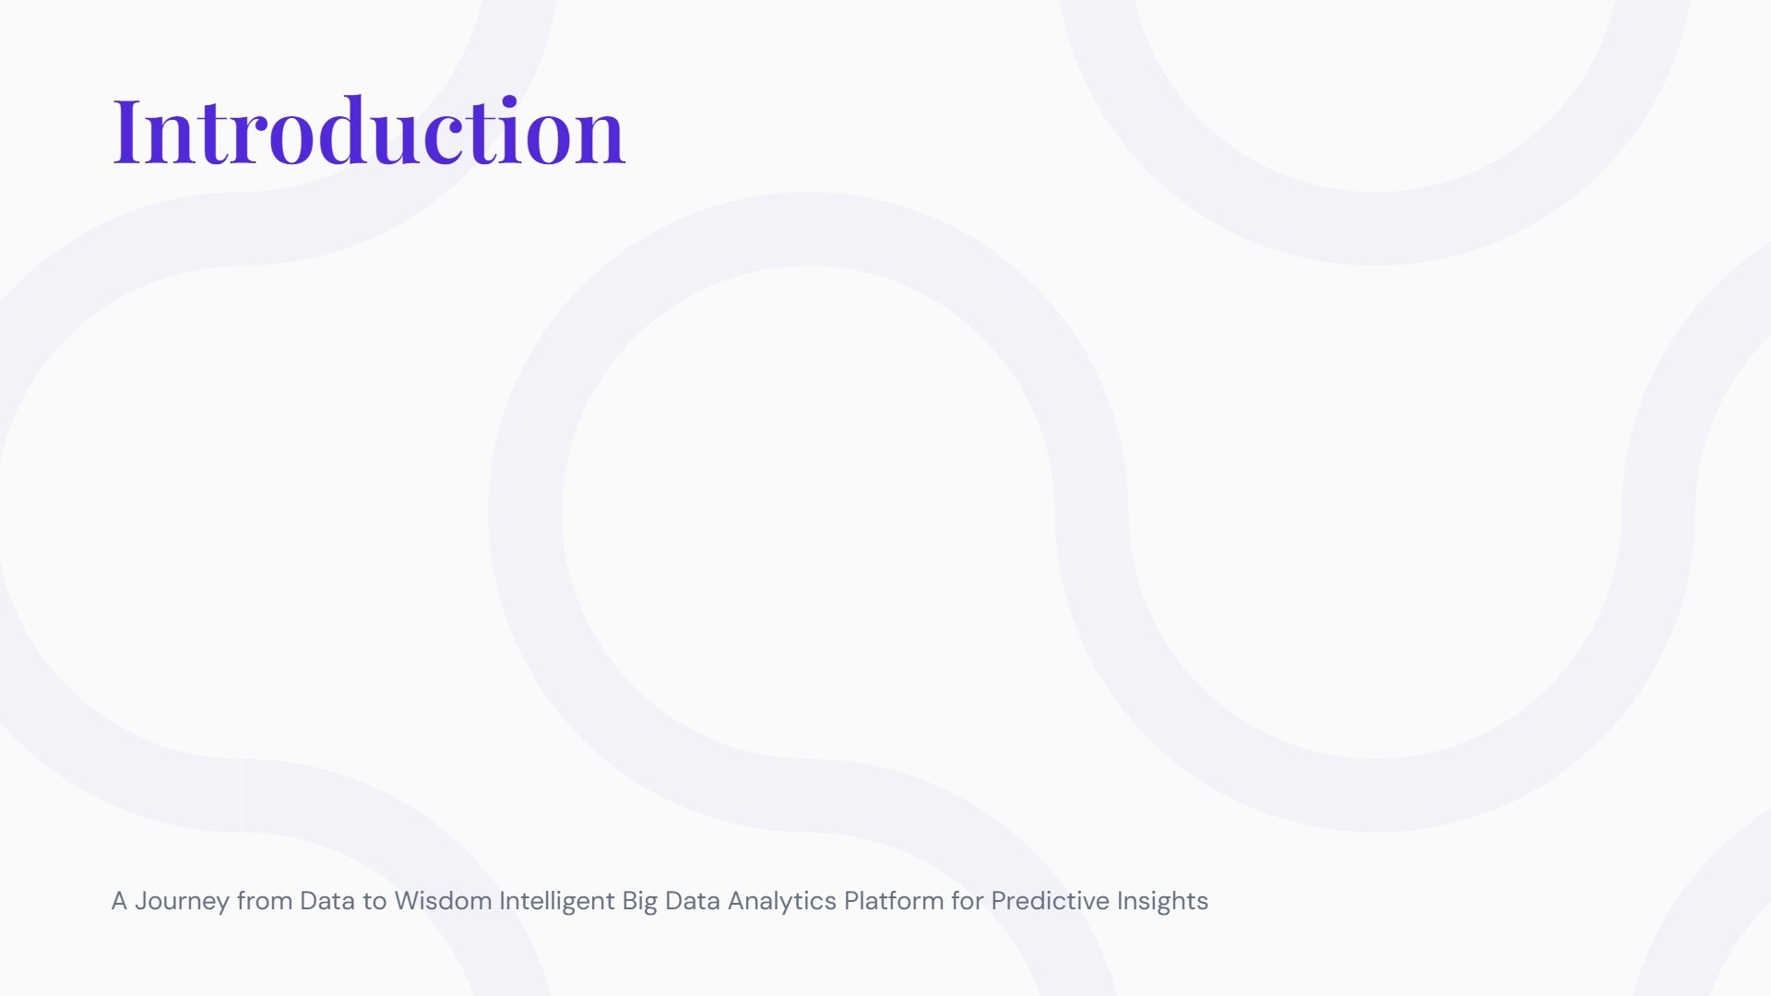
Develop an end-to-end data analytics platform that ingests, processes, analyzes, and visualizes large-scale data to provide predictive insights using advanced machine learning techniques. It made a comprehensive analysis and wide coverage by giving light to five major cutting-edge subjects: Big Data Analytics, Database Management System and technologies, Data Mining and Artificial Intelligence, Multivariate Data Analytics, Deep learning and Neural Network. This work is an effort to understand the core concepts and it’s applied in the domain. Hope you will enjoy the work. Constructive criticism is most welcome.

Slide 3
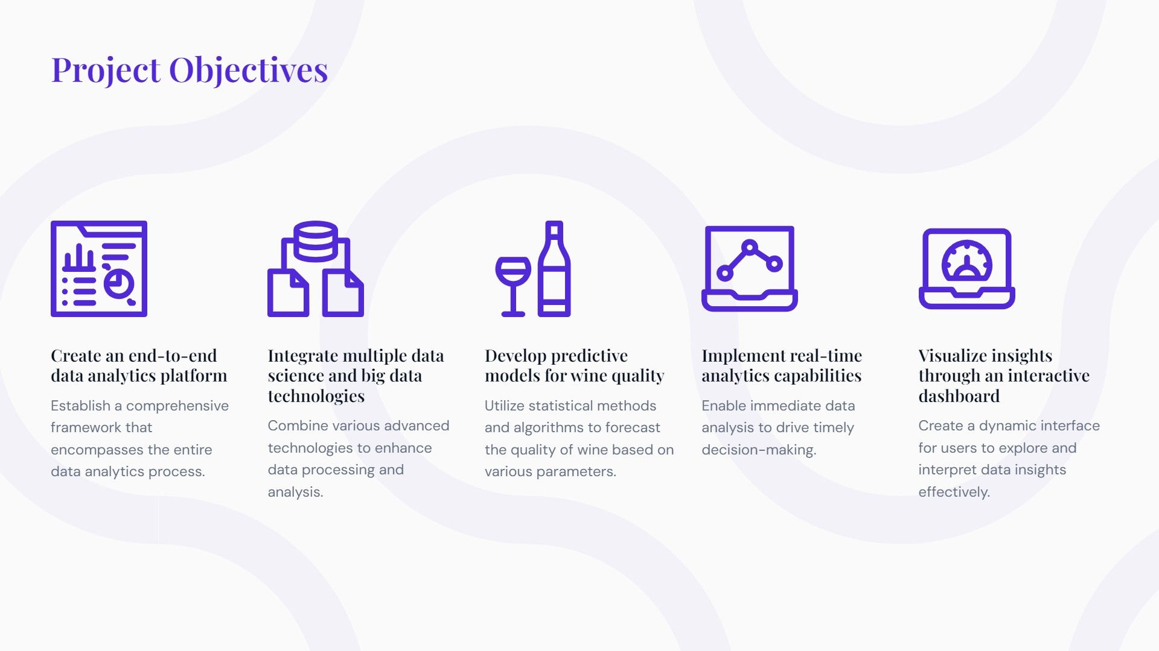

Slide 4
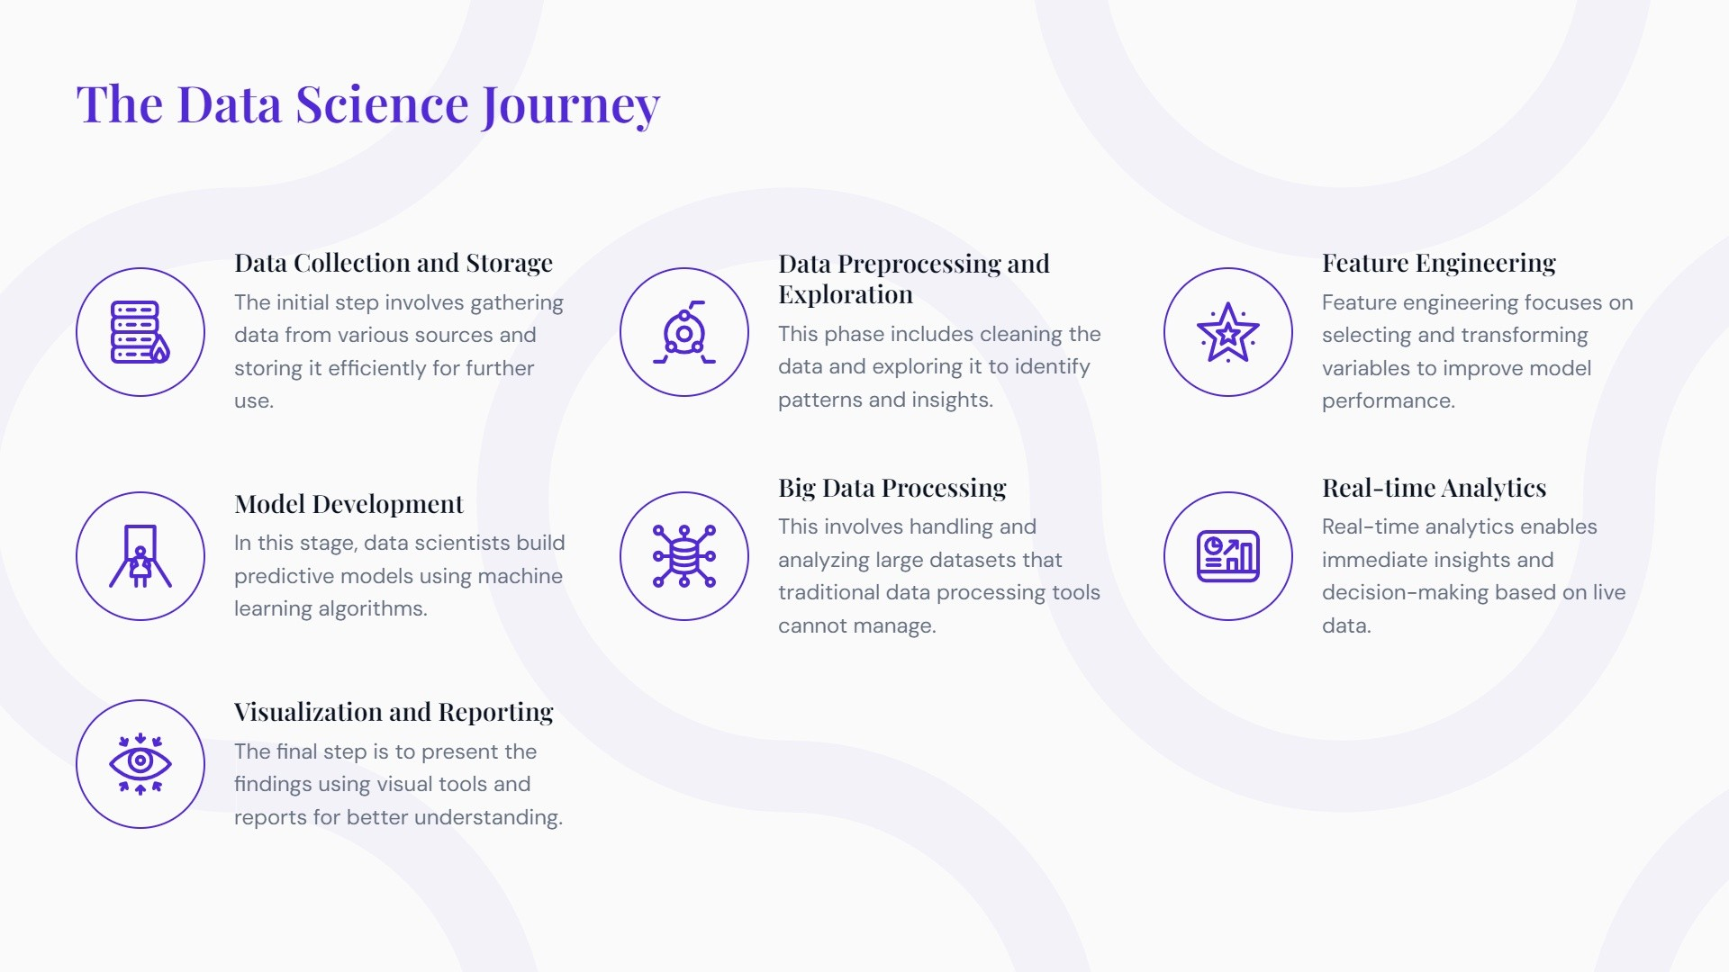

Slide 5
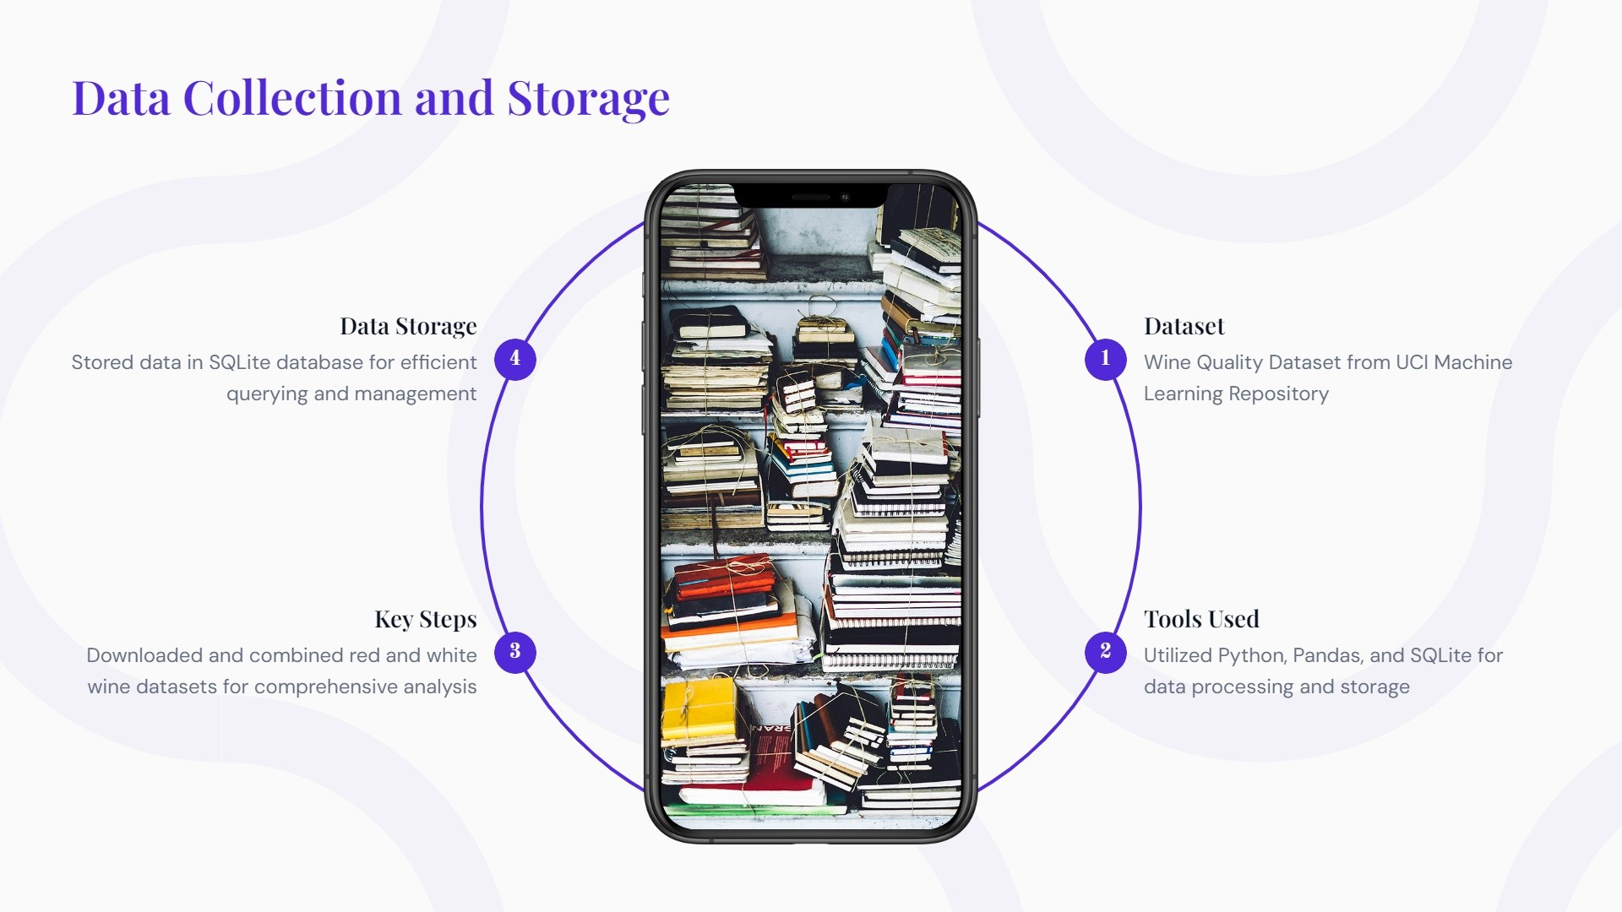
Step 1
Target variable (quality)

Slide 6
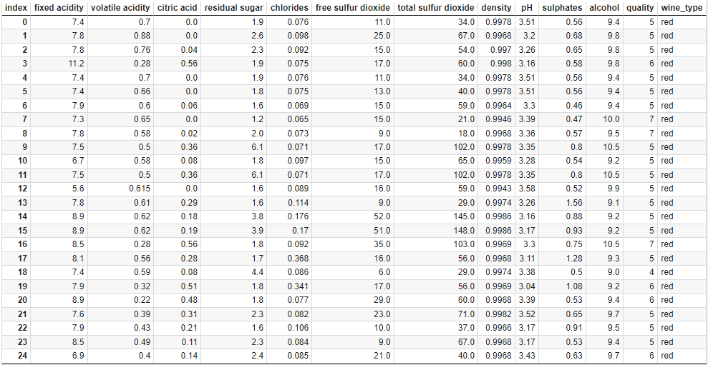

Slide 7
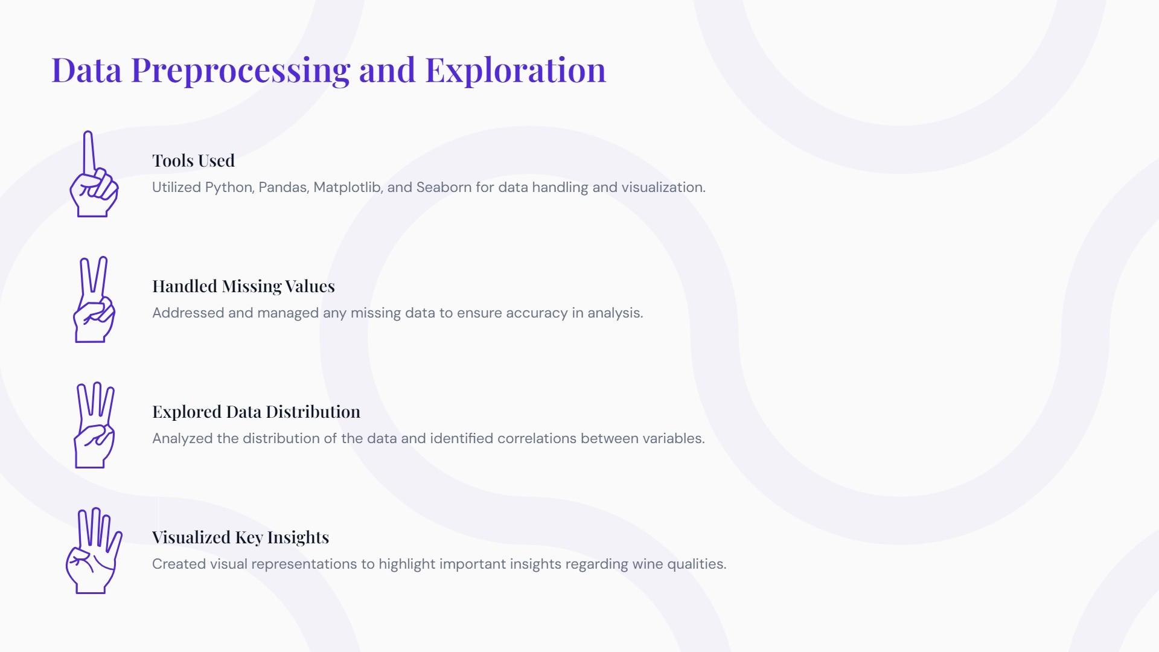
Step 2

Slide 8
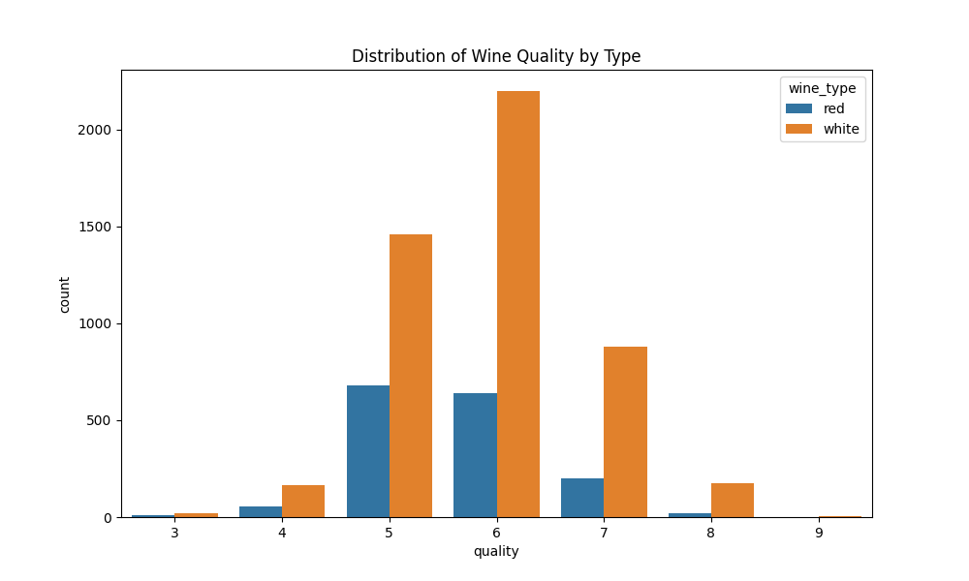

Slide 9
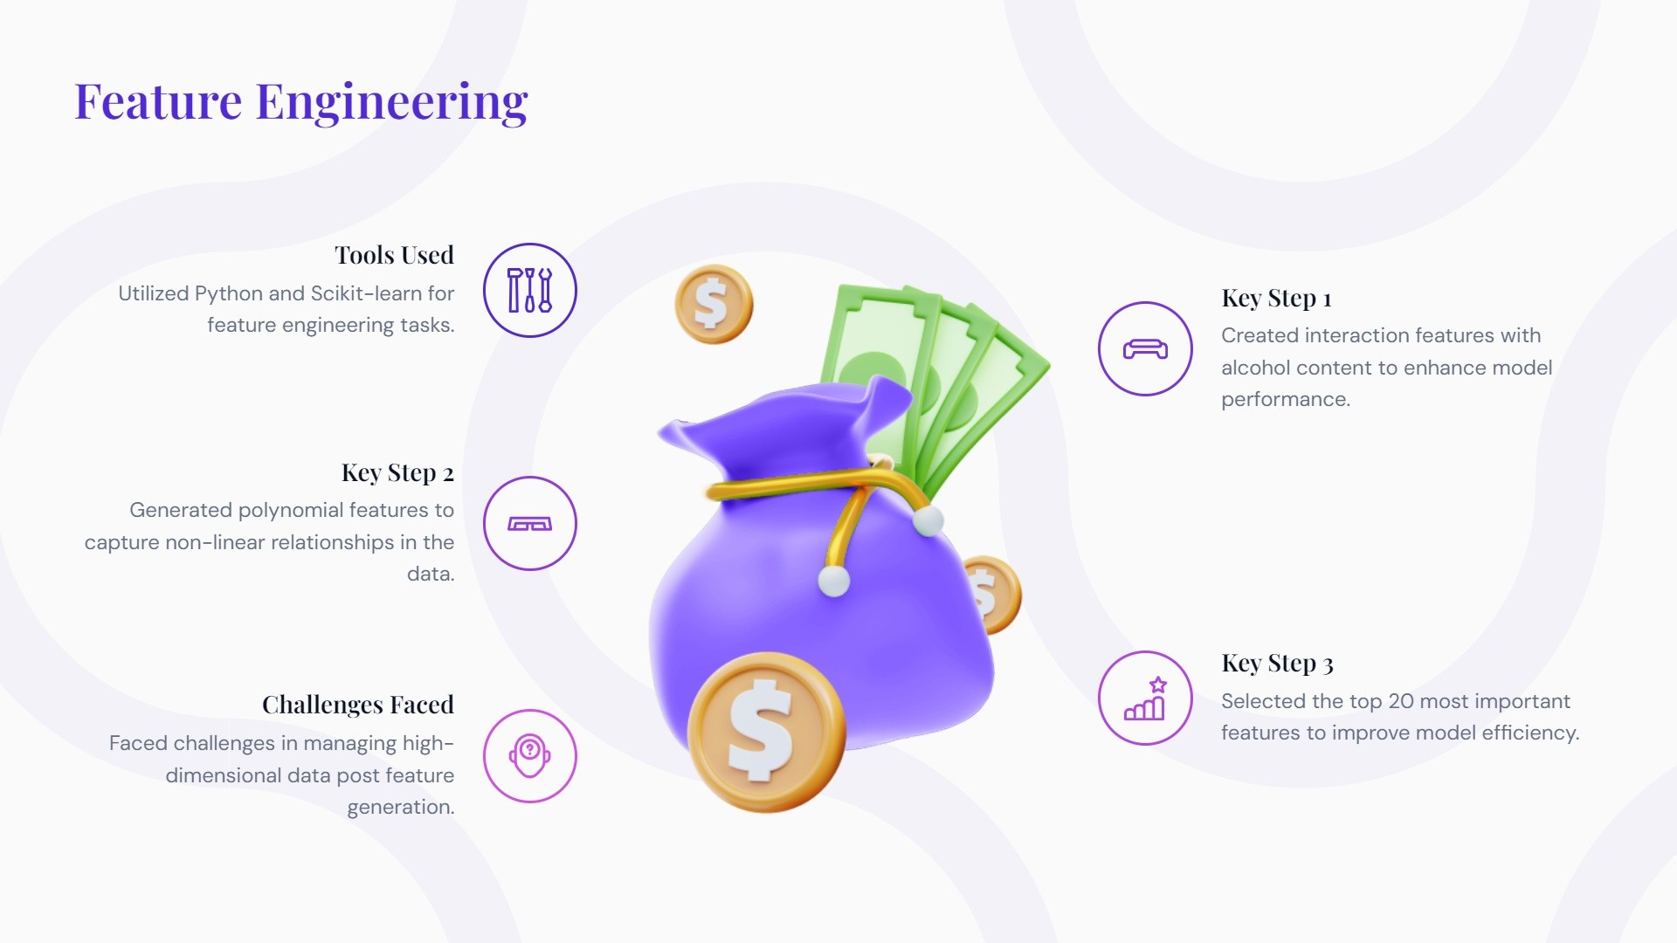
Step 3

Slide 10
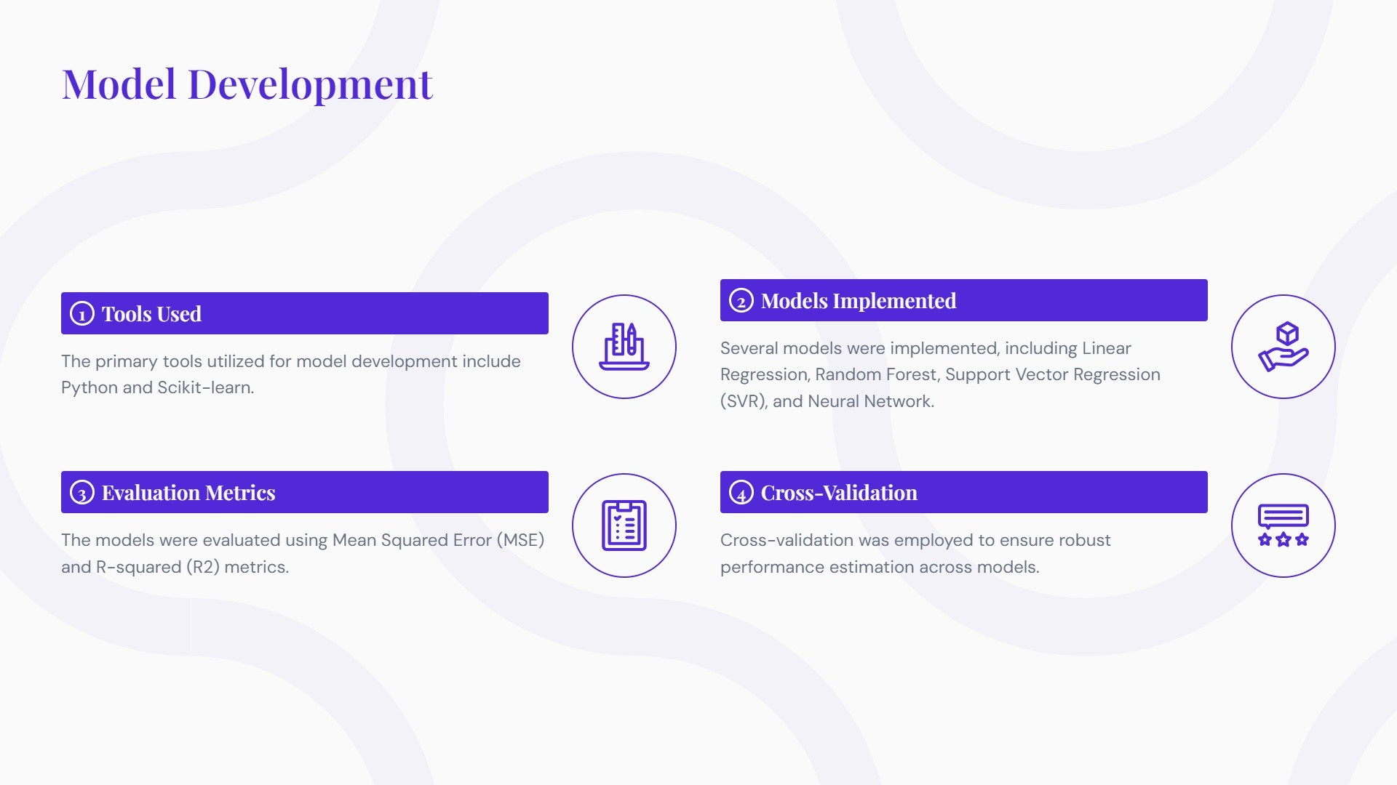
Step 4

Slide 11
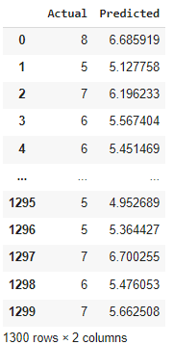
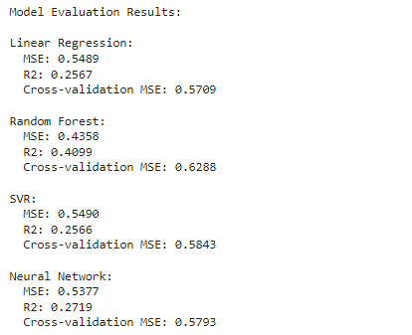

Slide 12
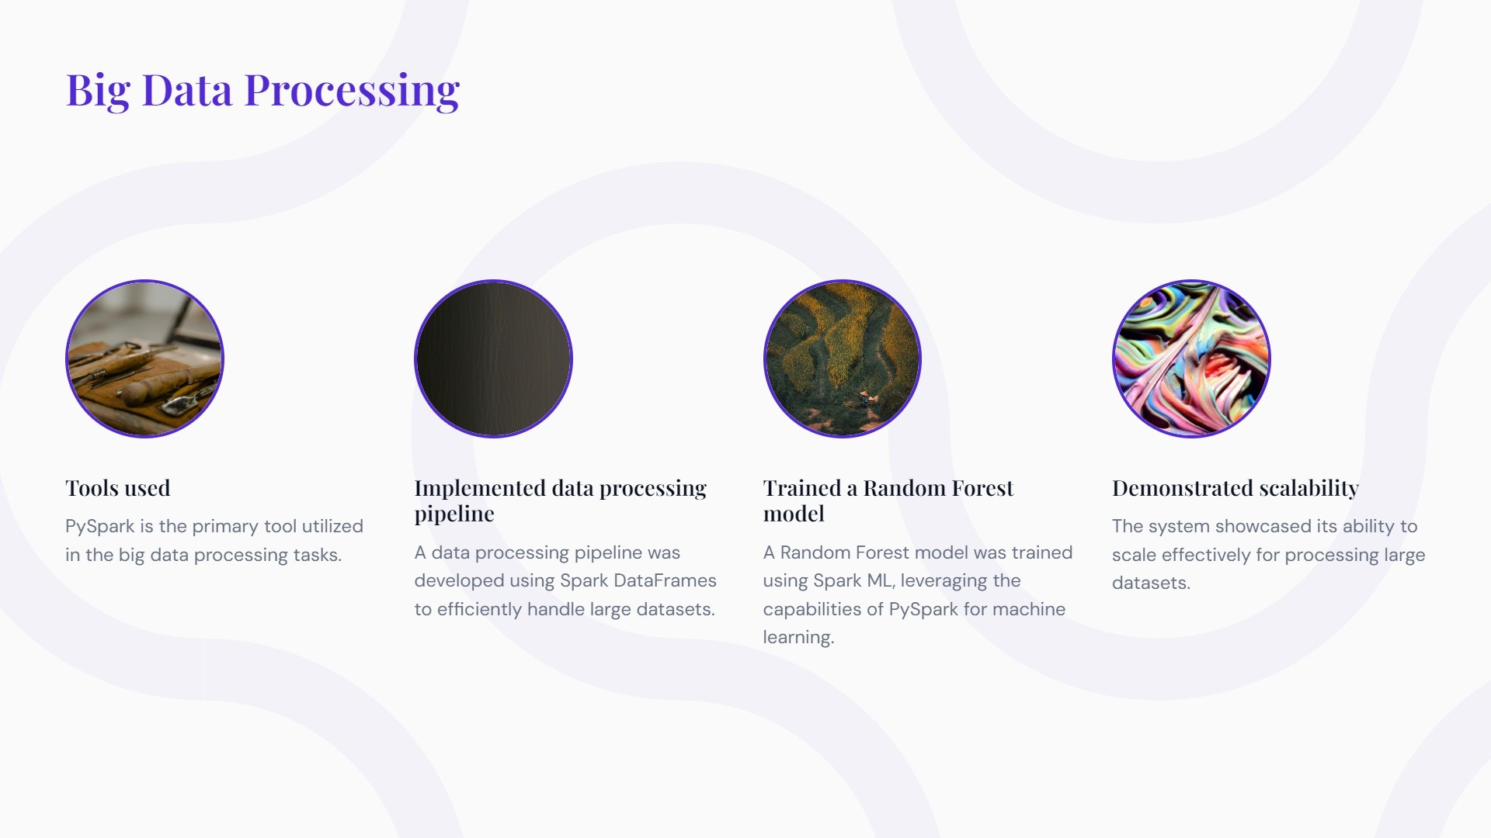
Step 5

Slide 13
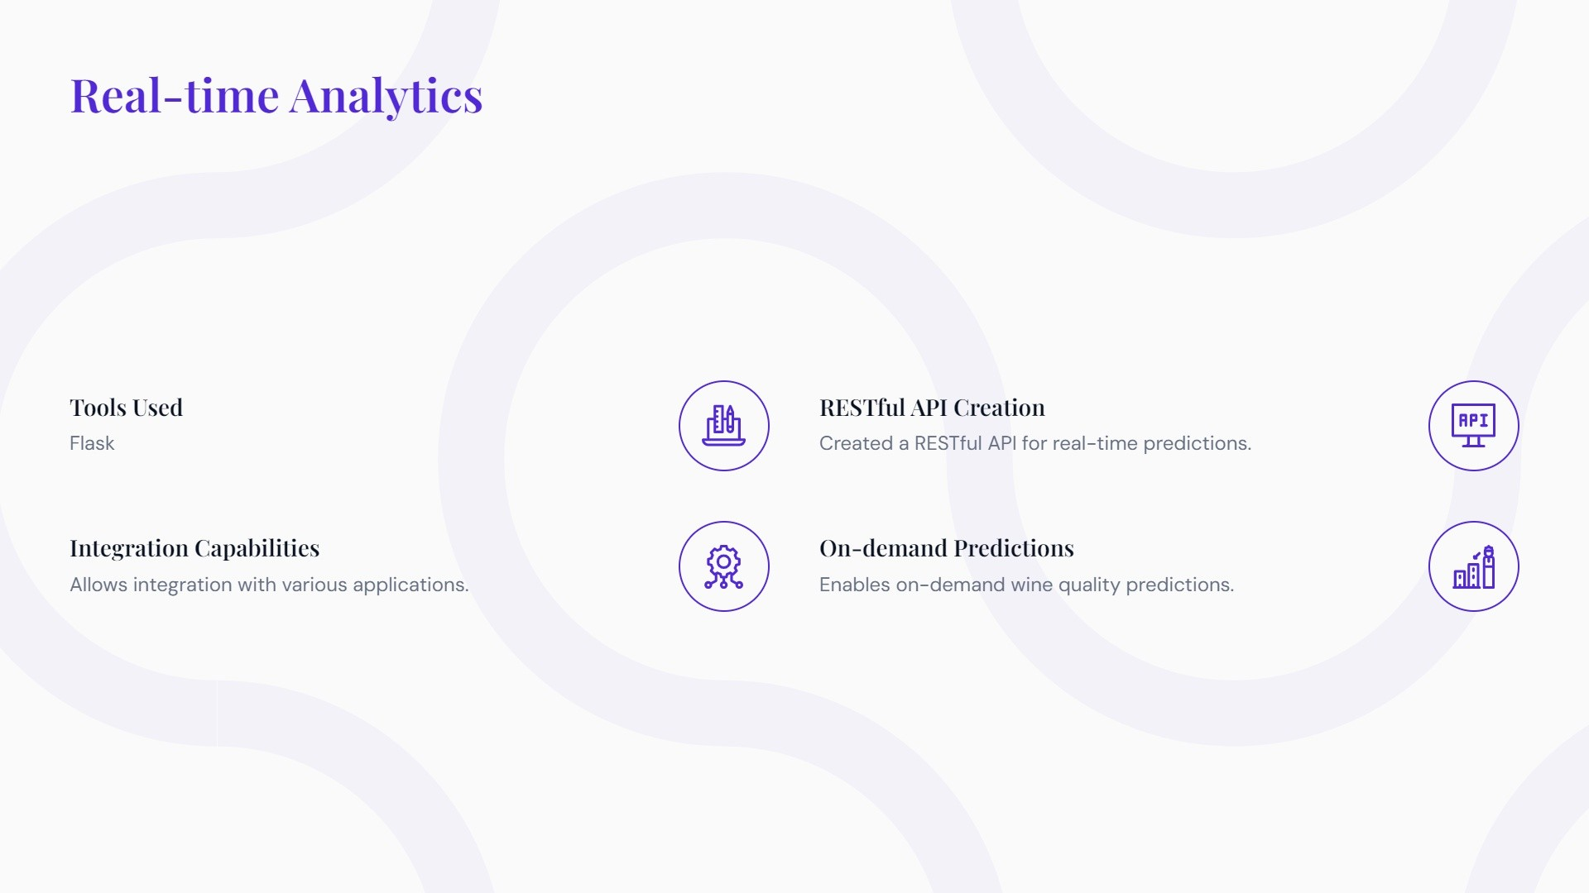
Step 6

Slide 14
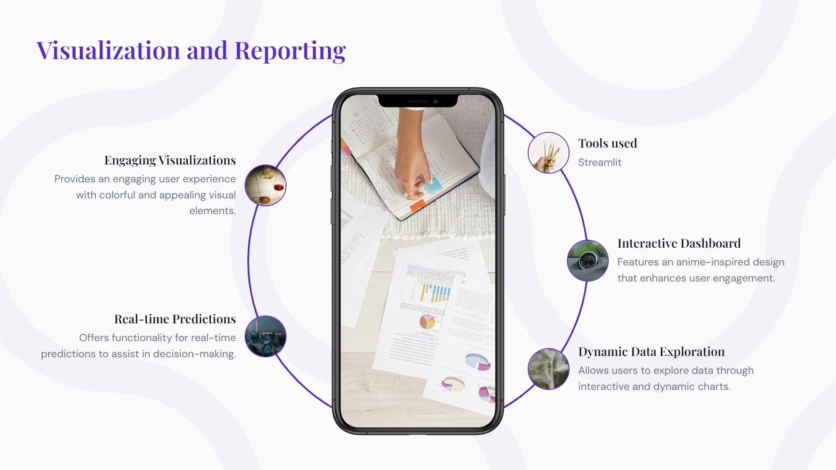
Step 7

Slide 15
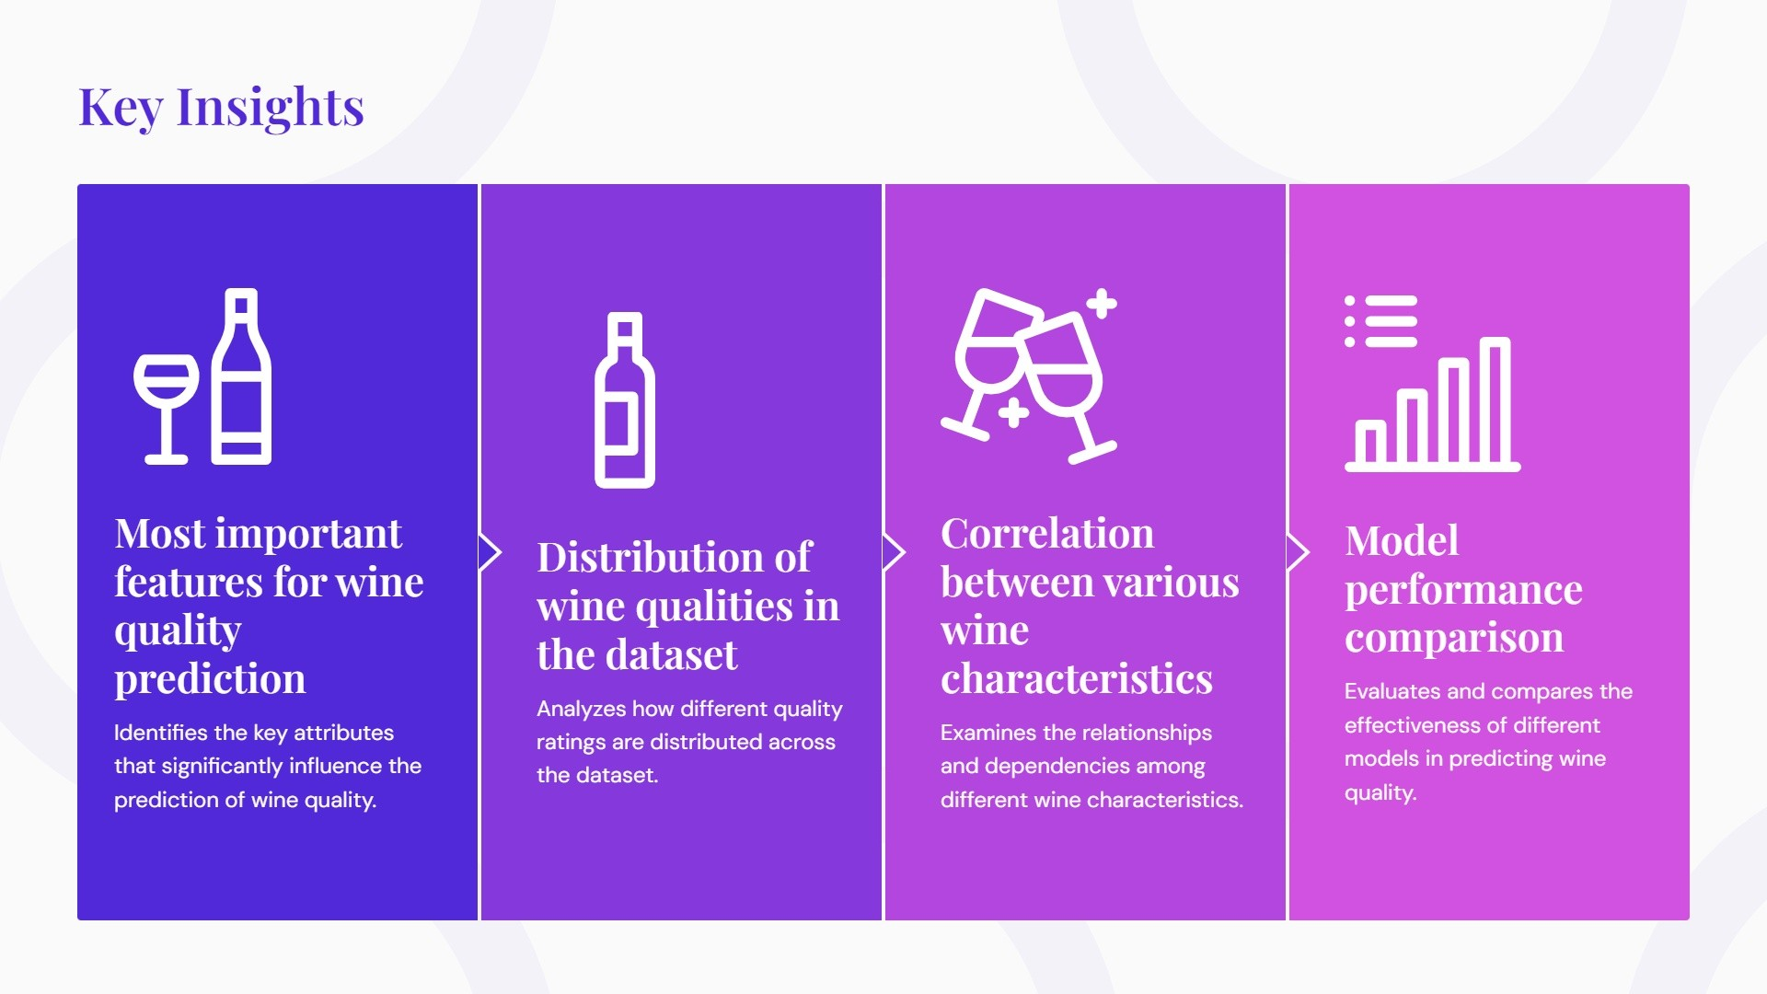

Slide 16
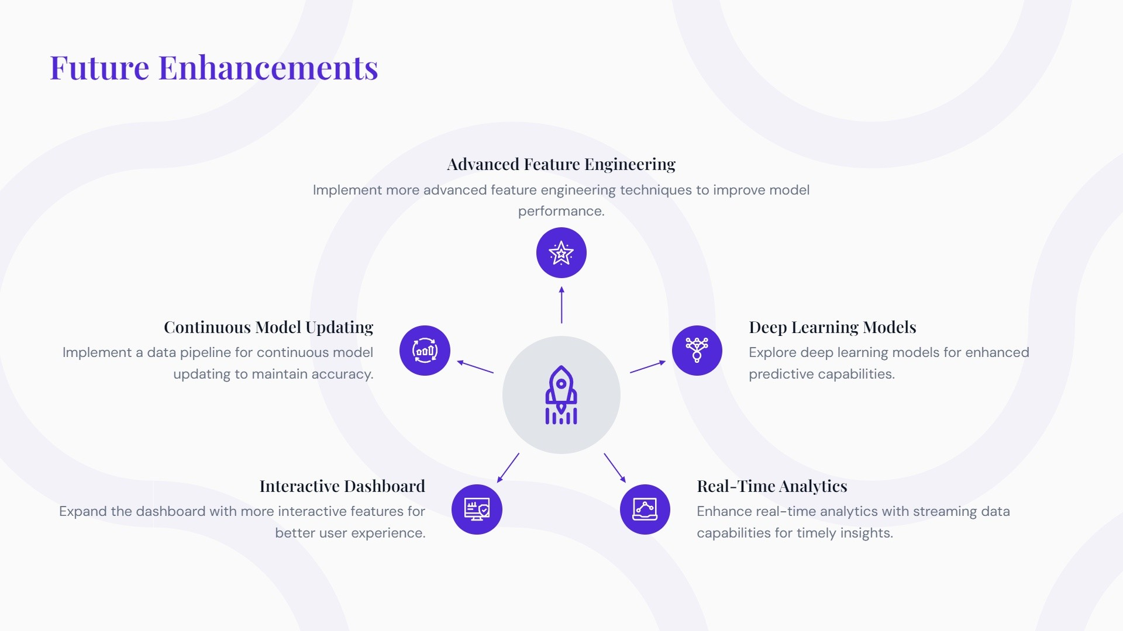

Slide 17
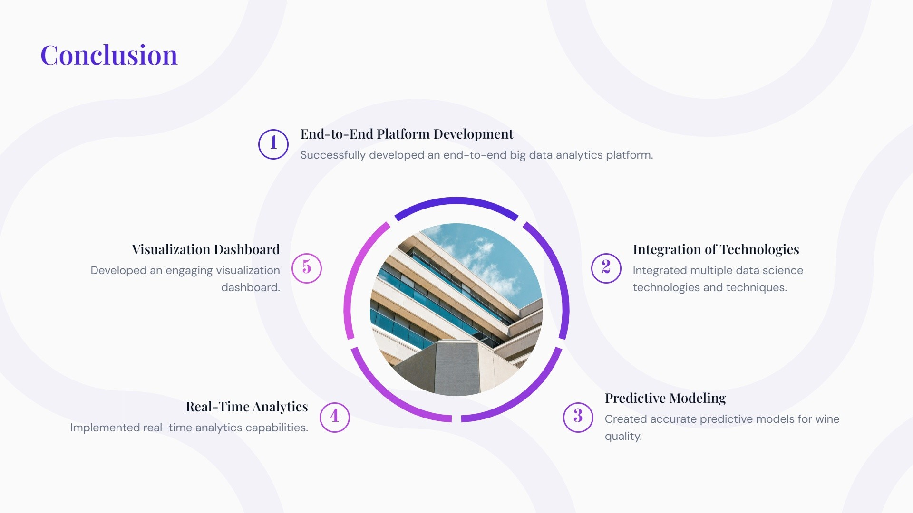

Slide 18


